Slide 1

INDUSTRIAL CAPSTONE PROJECT
FeatureBot
Feature Engineering with AI Guidance
AI-guided feature engineering for adult income classification
Department
Project code
Business Intelligence & Analytics
FB-FE-2025-Q3
Priority
Timeline
High
4 weeks
Notes:
Welcome the board. This project builds FeatureBot, an AI-guided workflow for finding and validating predictive features on the UCI Adult Income dataset. We will cover context, data, method, results, fairness, and delivery, about 30 minutes plus questions.

Slide 2






Agenda
01 · CONTEXT
Agenda
01
02
03
Context
Data
Method
Problem, client, objectives
Dataset, quality, class balance
FeatureBot loop, pipeline, roadmap
04
05
06
Results
Fairness
Delivery
Features, models, holdout
Subgroup audit, mitigations
Scorecard, risks, next steps
Notes:
Click any card to jump to that section. The Agenda button at the top right of every slide brings you back here.

Slide 3
Executive summary
01 · CONTEXT
Agenda
0.928
0.730
2 cycles
13.2 pts
Enhanced AUC, holdout
Enhanced F1, holdout
13 features proposed
Male–female TPR gap
from 0.904 baseline (+2.4 pts)
from 0.689 baseline (+4.0 pts)
8 in Cycle 1, 5 in Cycle 2
Two mitigations tested
Features help linear models, not trees. Logistic regression gains about +1 point; boosting already finds the nonlinearity.
The +3 to 5 point F1 target is met only by combining features with gradient boosting (+4.0 F1). AUC reaches +2.4.
Fairness is visible and priced. Excluding sensitive features or using group thresholds narrows the gap, each at a cost.
Notes:
Four numbers to remember. Features alone gave a small lift on logistic regression; the full lift needs features plus a stronger model. Fairness gaps exist and are documented with mitigations.

Slide 4

Project overview
01 · CONTEXT
Agenda
Purpose: build FeatureBot, an AI-guided loop that proposes, tests and selects features for income classification (<=50K vs >50K).
Scope: Colab workflow with ChatGPT prompting, feature registry, baseline and enhanced models, holdout evaluation, client-ready documents.
Data: UCI Adult Income, 48,842 records.
Measurable lift
A strong baseline to beat, tracked by AUC and F1.
Transparent and reproducible
Registry, experiment log, fixed seeds.
Fairness built in
Subgroup metrics and documented mitigation.
Notes:
State the purpose in one sentence: speed up finding good features, and make the process auditable and fair.

Slide 5



Client background
01 · CONTEXT
Agenda
Industry
Team profile
Constraints
Data science.
Tabular machine learning for income classification.
BI and analytics stakeholders who want faster iteration on tabular ML problems and repeatable feature engineering approaches.
Colab-based development.
Lightweight tooling.
Deliverables in .docx format.
Notes:
The client is a BI and analytics group that wants repeatable feature engineering. Their constraints shaped the tooling: Colab, lightweight libraries, Word documents.

Slide 6



From problem to outcome
01 · CONTEXT
Agenda
Problem
Approach
Outcome
Manual feature work is slow
Results are inconsistent
Impact is unclear
Fairness is checked too late
Context: schema, EDA, errors
Propose: ideas with pseudocode
Implement: toggles, config IDs
Evaluate: CV, keep winners
AUC and F1 lift measured
Pipeline is reproducible
Registry documents every feature
Fairness is reported
▶
▶
Notes:
Read left to right. Slow and inconsistent feature work becomes a four-step loop, which produces measured, reproducible, fair results.

Slide 7


User story and objectives
01 · CONTEXT
Agenda
As a Data Scientist
Implement the loop
Propose, implement, evaluate, select.
responsible for model performance, I want an AI-guided feature engineering workflow with actionable suggestions so that I can efficiently create high-value features, improve accuracy, and maintain fairness and reproducibility.
Establish governance
Feature registry and experiment log with metric deltas.
Ensure reproducibility
Deterministic splits, train-only fitting, documented prompts.
Provide fairness diagnostics
Subgroup metrics and documented mitigations.
Notes:
The user story is the test for every decision. The four objectives are how we deliver it.

Slide 8
The dataset at a glance
02 · DATA
Agenda
48,842
14
23.9%
3
Records
Predictors
Earn >50K
Sensitive attributes
plus the income target
class imbalance
sex, race, marital status
Sample records
age | workclass | education | marital-status | gender | income
25 | Private | 11th | Never-married | Male | <=50K
38 | Private | HS-grad | Married-civ-spouse | Male | <=50K
28 | Local-gov | Assoc-acdm | Married-civ-spouse | Male | >50K
44 | Private | Some-college | Married-civ-spouse | Male | >50K
18 | ? | Some-college | Never-married | Female | <=50K
Notes:
Public UCI Adult Income data. Note the three sensitive attributes, which drive the fairness work later.

Slide 9
Data quality: missing values and skew
02 · DATA
Agenda
Missing values (encoded "?")
Skewness of numeric features
"?" is converted to missing and imputed with the most frequent value; no rows are dropped.
92% of capital-gain values are zero, so a "gain > 0" flag and a log1p transform are natural features.
Notes:
Missing values appear in three columns and are encoded as a question mark. Capital gain and loss are extremely skewed, with most values zero, which motivates the indicator and log features.

Slide 10


Class balance
02 · DATA
Agenda
Why accuracy misleads
Predicting "<=50K" for everyone is already 76% accurate.
What we optimise
AUC for ranking and F1 on the >50K class for decisions.
Threshold tuning
Chosen on validation only, then frozen for the holdout.
Notes:
About one in four people earns more than 50K. That is why we track F1 on the positive class and tune the decision threshold, not only accuracy or AUC.

Slide 11





The FeatureBot loop
03 · METHOD
Agenda
1 Context
▶
2 AI proposes
▶
3 Implement
▶
4 Evaluate
Schema, missingness, baseline metrics, top errors
Ideas, rationale, leakage flags, pandas pseudocode
Toggles in add_feature_block, config IDs
Stratified CV, deltas, keep winners
Feature registry and experiment log record every proposal, every delta and every decision, so the process can be audited and repeated.
Notes:
Each cycle: give the AI the context, receive proposals with leakage flags, implement behind toggles, evaluate with cross-validation and keep only the winners. Every pass is recorded in the registry.

Slide 12
Three structured prompt templates
03 · METHOD
Agenda
A
Template A
B
Template B
C
Template C
Features
False negatives
Fairness
Given schema + EDA, propose 5 transformations with rationale, leakage risk and pandas pseudocode; optimise for F1 on >50K.
Given validation errors, suggest 3 interactions to reduce false negatives; provide code and fairness notes.
Given subgroup metrics, propose mitigations with minimal overall F1 loss; include steps.
Notes:
Fixed templates reduce prompt variability. Template A finds features, B targets false negatives, C proposes fairness mitigations. A human reviews every suggestion.

Slide 13


A leakage-safe pipeline
03 · METHOD
Agenda
1
2
3
Load and clean
Split 60/20/20
Add features
"?" to missing; labels normalised
Stratified, seed 42
Row-wise only, via toggles
4
5
6
Fit on train only
Tune threshold
Report once
Impute, scale, one-hot, model
On validation only
Retrain on train+val, test once
Notes:
Nothing from validation or test data influences training. Imputers and scalers are fitted on train only, features are row-wise, and the holdout is used once at the end.

Slide 14




Feature engineering strategy
03 · METHOD
Agenda
Encodings
Numeric transforms
Indicators
One-hot for low cardinality; target or frequency encoding for occupation and country.
log1p for capital gain, loss and fnlwgt; bins for age and hours.
capital_gain_gt0, capital_loss_gt0, overtime (hours > 40).
Interactions
Groupings
Selection
age x education; marital x relationship; workclass x hours bin.
Education buckets; region buckets for native country.
Univariate filters, importances, stepwise addition with CV stability.
Notes:
Six families of features. We tested the first four in the two cycles; encodings and selection are the next experiments.

Slide 15
Five phases over four weeks
03 · METHOD
Agenda
1
2
3
4
5
Week 1
Week 2
Weeks 2–3
Week 3
Week 4
Initiation and data audit
FeatureBot Cycle 1
Cycle 2 and ablations
Fairness and mitigation
Finalise and hand over
EDA, baseline
8 proposals, CV
5 proposals, pruning
Subgroups, trade-offs
Holdout, documents
Notes:
Phase 1 audits the data, phases 2 and 3 are the FeatureBot cycles, phase 4 is fairness, phase 5 delivers.

Slide 16
Cycle 1: eight feature proposals
04 · RESULTS
Agenda
capital_gain_gt0
Gain > 0 flag
capital_loss_gt0
Loss > 0 flag
0.915
0.705
Val AUC
Val F1
log_capital_gain
log1p of gain
log_capital_loss
log1p of loss
from 0.907
from 0.696
age_bin
5 age bands
hours_bin
4 hours bands
Logistic regression, validation set. Threshold tuned on validation.
overtime
Hours > 40
age_x_education
Seniority proxy
Notes:
Cycle 1 produced the main gain. The capital-gain flag and the age bins were the strongest single features.

Slide 17

Single-feature impact
04 · RESULTS
Agenda
Keep
age_bin, gain flag and log, hours bin, gain x education.
Drop candidates
age x education, education bucket, region, marital x relationship.
Notes:
Each bar is one feature added alone to the baseline. Gains are small and close to fold noise, so we read them together with cross-validation stability. Drop candidates are the negative ones.

Slide 18
Cycle 2 and ablations
04 · RESULTS
Agenda
Features | Model | Val AUC | CV AUC | Val F1 | Reading
None | LR | 0.907 | 0.904 | 0.696 | Reference
Cycle 1 | LR | 0.915 | 0.912 | 0.705 | Main gain
Cycle 1 + 2 | LR | 0.915 | 0.912 | 0.703 | No further change
None | GB | 0.929 | 0.925 | 0.729 | Reference
Cycle 1 | GB | 0.929 | 0.924 | 0.729 | Slightly lower CV F1
Cycle 1 + 2 | GB | 0.929 | 0.924 | 0.730 | Flat AUC, recall up
Fold-to-fold standard deviation stays near 0.001 to 0.003 for AUC.
Removing Cycle 2 does not hurt logistic regression, so most of its features are flagged as drop candidates.
Notes:
Cycle 2 targeted false negatives. For logistic regression it added nothing on top of Cycle 1, which is itself a useful finding. For boosting, features raise recall but not AUC.

Slide 19
Validation performance by configuration
04 · RESULTS
Agenda
Validation set (9,769 rows). LR = logistic regression, GB = gradient boosting. Value axis starts at 0.60.
Notes:
Boosting is a clear step up in AUC. Note the axis starts at 0.60 to make differences visible.

Slide 20
Holdout test results
04 · RESULTS
Agenda
Model | AUC | F1 | Precision | Recall | PR AUC
Baseline LR | 0.904 | 0.689 | 0.659 | 0.723 | 0.763
Enhanced LR | 0.913 | 0.700 | 0.636 | 0.779 | 0.787
Baseline GB | 0.929 | 0.729 | 0.704 | 0.755 | 0.832
Enhanced GB | 0.928 | 0.730 | 0.673 | 0.796 | 0.830
+2.4
+4.0
172
AUC points
F1 points
Fewer missed >50K
Enhanced GB vs baseline LR
Within the +3 to 5 target
False negatives: 648 to 476
Notes:
The holdout was used once. Enhanced boosting gives the best AUC and F1. Recall improves most, which is what Template B was aimed at.

Slide 21
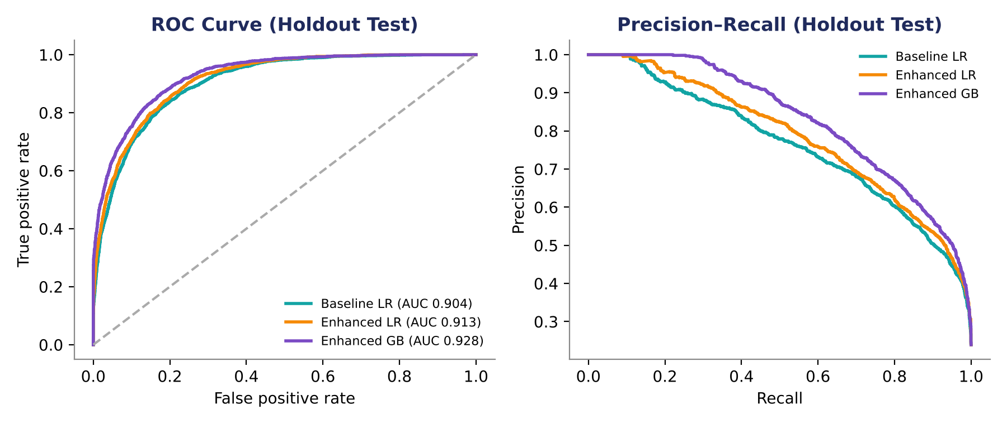
ROC and precision-recall curves
04 · RESULTS
Agenda
ROC
Enhanced GB AUC 0.928 vs baseline 0.904.
PR AUC
Holdout test set, 9,769 rows.
0.830 vs 0.763 for baseline.
Notes:
The enhanced models sit above the baseline across the range, most clearly in the precision-recall view that matters for the minority class.

Slide 22
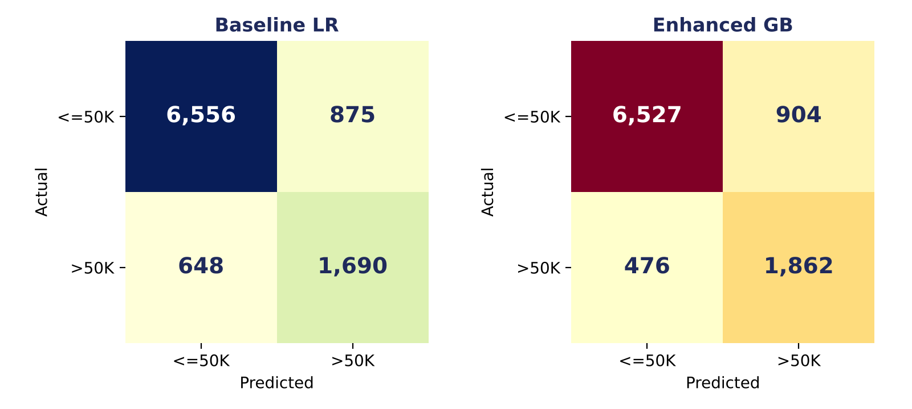
Where the gains come from
04 · RESULTS
Agenda
Recall rises from 0.723 to 0.796 on the holdout.
Features help the linear model: +0.9 AUC, +1.1 F1 points.
Trees already find the nonlinearity: AUC stays flat at 0.928, recall improves.
Trade-off: precision slips from 0.704 to 0.673 for boosting.
Confusion matrices at validation-tuned thresholds.
Notes:
Fewer missed high earners: recall rises, precision gives a little back. Features help the linear model; trees already find the nonlinearity.

Slide 23
Fairness: results by sex
05 · FAIRNESS
Agenda
Subgroup | n | F1 | AUC | TPR | FPR | Selection rate
Sex: Male | 6,510 | 0.709 | 0.891 | 0.800 | 0.199 | 0.381
Sex: Female | 3,259 | 0.649 | 0.937 | 0.668 | 0.049 | 0.117
Parity ratios (Female / Male)
0.83
0.24
0.31
TPR ratio
FPR ratio
Selection-rate ratio
1.00 would be equal opportunity
Women are flagged less often in error
Part of this is the base rate
Notes:
Women are selected far less often. Part of that is the data, since 11% of women and 30% of men earn more than 50K, but the model adds a true-positive gap on top, which is what we mitigate.

Slide 24
Fairness: marital status and race
05 · FAIRNESS
Agenda
True-positive rate by marital status
Race
TPR: White 0.789, Black 0.636, Asian-Pac-Islander 0.793.
Handle with care
Groups under about 100 holdout rows are too small to over-read.
Notes:
Marital status shows the widest spread and is also the strongest predictor, so it is both the most useful and the most delicate attribute. Small race groups give noisy estimates.

Slide 25
Two mitigations and their cost
05 · FAIRNESS
Agenda
Approach | F1 | AUC | TPR gap
None | 0.700 | 0.913 | 13.2 pts
M1 | 0.635 | 0.867 | 5.2 pts
M2 | 0.693 | 0.913 | -2.8 pts
M1: AUC falls to 0.867; marital status is also a proxy for sex.
M2: female threshold 0.16 vs male 0.34; may be restricted in regulated settings.
Decision for the board: where to set the line.
Holdout, enhanced logistic model. TPR = true-positive rate.
Notes:
M1 removes sensitive features and narrows the gap, but accuracy drops sharply because marital status carries real signal. M2 uses separate thresholds, keeps AUC, and nearly equalises opportunity, but uses sex at decision time. No option is free.

Slide 26
Acceptance criteria scorecard
06 · DELIVERY
Agenda
Criterion | Status | Evidence
No leakage; robust preprocessing | Met | Train-only fitting, row-wise features
2+ cycles, 5+ proposals each | Met | Cycle 1: 8, Cycle 2: 5
+3 to 5 pts AUC or F1 | Partly met | F1 +4.0 met; AUC +2.4 short
Stable on holdout | Met | Within 0.002 of validation
Fairness report + mitigation | Met | Sex, race, marital; two mitigations
Reproducible; registry and summary | Met | Seed 42; scripts and CSVs
Notes:
Five of six criteria are met. The lift criterion is partly met: F1 reaches the target, AUC does not. We report that honestly rather than moving the goalposts.

Slide 27


Deliverables
06 · DELIVERY
Agenda
Project document
Notebook and scripts
Feature registry
Word (.docx) with all sections and acceptance criteria.
End-to-end pipeline and FeatureBot cycles, runnable in Colab.
CSV: definition, type, leakage risk, deltas, decision.
Experiment log
Evaluation summary
Fairness report
CSV: configurations, CV and holdout metrics, runtime.
Baseline vs enhanced, confusion matrices, ROC and PR.
Subgroup metrics and mitigation trade-offs.
Notes:
Everything is in the GitHub-ready package: documents, scripts, registry and logs, with a README for running it.

Slide 28
Risks and mitigations
06 · DELIVERY
Agenda
Risk | Level | Mitigation
Data quality and skew | Medium | Standard cleaning, log transforms, QA checks
Overfitting | Medium | K-fold, holdout, small feature batches
Fairness | High | Subgroup reporting, exclusion, threshold tuning
Colab limits | Low | Compact models, batching, caching
Prompt variability | Medium | Fixed templates, rich context, human review
Notes:
Fairness is the one high-rated risk. The rest are routine and controlled by the method.

Slide 29

Decisions and next steps
06 · DELIVERY
Agenda
Decisions requested
Proposed next steps
Which fairness approach to adopt (M1, M2 or both reported).
Whether to move forward with boosting as the production model.
Tune gradient boosting; add SHAP explanations; test CatBoost target encoding for occupation and country.
Delivery plan (completed)
Week 1
Week 2
Week 3
Week 4
Audit and baseline
Cycle 1
Cycle 2, fairness
Final and handover
Notes:
Close on the ask. Two decisions are needed from the board, followed by the experiments we propose.

Slide 30

Thank you
Questions and discussion
FeatureBot · FB-FE-2025-Q3 · Business Intelligence & Analytics
Back to agenda
Notes:
Invite questions. Likely ones: why is the AUC lift under 3 points (the logistic baseline is already strong; boosting is the main lever), and which fairness mitigation to adopt.

